Slide 1
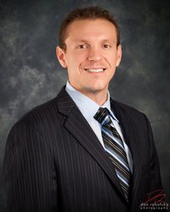
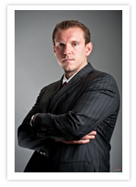
EB-5 Foreign Investment “Green Card For Sale”
The Law Offices of Yuri Tsyganov, PL 111 N. Pine Island Road Suite 205 Plantation, FL 33324 www.TsyganovLaw.com
EB-5

Slide 2
What is the EB-5 Program?
EB-5 Program was established in 1990 via PL101-649. •
Section 203(b)(5):
“allows for the admission to permanent residence on a two-year conditional basis to qualified aliens who will contribute to the economic conditional basis to qualified aliens investing in U.S. businesses and creating growth of the U.S. by employment opportunities.” [Source: USCIS]
The new commercial enterprise may take any lawful business form, including a limited partnership:
But the investment must:
Benefit the U.S. economy, and
Directly create not fewer than 10 new “qualifying employees”
Job creation CAN be “indirect”
www.EB5InvestGreenCard.com

Slide 3
Why EB-5?
• The EB-5 Visa offers more advantages and fewer constraints than ANY other visa program in the world!
• The U.S. has NO REQUIREMENTS as to:
AGE
BUSINESS TRAINING
MANAGEMENT SKILL
LANGUAGE SKILLS PRIOR EXPERIENT
EMPLOYMENT
REQUALIFICATION ONCE RESIDENCY IS OBTAINED
• The investor, their spouse and unmarried children (under 21) ALL enjoy the benefit of permanent residency in the U.S. (Green Card).
www.EB5InvestGreenCard.com

Slide 4
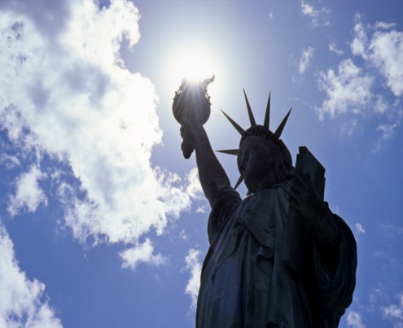
How Is It Done?
There Are Three (3) Ways to Invest Within the EB-5 Category
Creating a new or existing commercial enterprise
2)Investing in a troubled business
3)Investing in a USCIS approved Regional Center
www.EB5InvestGreenCard.com

Slide 5
New Business Enterprise
In order to qualify the Investor must:
Invest or be in the process of investing at least $1,000,000. If your investment is in a designated Targeted Employment Area (TEA) then the minimum investment requirement is $500,000.
A TEA is an area that has experienced high unemployment of at least 150 % of the national average.
Florida Agency for Workforce Innovation (AWI)
The area may include a geographic area or subdivision within MSA, a city, or town, i.e., can be as small as a Census Tract

Slide 6
New Business Enterprise
Investment must benefit the U.S. economy by providing goods or services to U.S. markets
Create or preserve full-time employment for at least 10 U.S. workers. This includes U.S. citizens, Green Card holders (lawful permanent residents) and other individuals lawfully authorized to work in the U.S. However, this does not include the investor, , his or her spouse, or children
Be involved in the day-to-day management of the new business or directly manage it through formulating business policy. The investor may assume the position of a corporate officer or board member of the business in order to fulfill this requirement.
The investor’s source of funds to fund the investment must be from a lawful source
Qualified Investor: Net worth of $1 million dollars between husband and wife EXCLUSIDING HOME RESIDENCE
MUST HAVE NO CRIMINAL RECORD

Slide 7
New Business Enterprise
Investor can buy in to an existing business, join in to a pool of investors who have already created a business, or expand an existing business
To qualify for creation based on expansion, the investor must demonstrate that the investment has increased, by 40 %, either the number of employees or the net worth of the business (10 ADDITIONAL EMPLOYEES NOT INCLUDED)
The petitioner will still be required to employ ten (10) additional employees before the conditional basis of his or her EB-5 permanent resident status may be removed

Slide 8
New Business Enterprise: Capital
The term “invest” is defined as a contribution of capital, which can be in the form of cash, equipment, inventory, other tangible property, cash equivalents and indebtedness secured by assets owned by the alien provided that he or she is personally and primarily liable and the assets of the new commercial enterprise are not used to secure any of the indebtedness.
If the alien uses a secured note, the alien must be able to show that this note has a real cash value, and that the total value of all capital invested, including the note, has a cash value equal to or greater than the statutory minimum.
All of the requisite capital must go directly into the new commercial enterprise; amounts paid for “administrative fees”, “attorneys’ fees” and other types of expenses not directly paid into the new commercial enterprise will not count towards the minimum investment amount.

Slide 9
Procedure
After the business choice is made, the investor’s immigration attorney begins the process of gathering the necessary documentation to complete and submit the Immigrant Petition by Alien Entrepreneur (USCIS from I-526)
After form I-526 is approved, overseas investors must attend an interview at a U.S. Consulate abroad.
Before and during the interview the investor and his or her family, undergo medical, police, security and immigration history checks before the conditional permanent resident visas are issued.
If the investor is legally in the U.S., then he or she will submit an application to adjust status to the appropriate to the appropriate USCIS office in the U.S.

Slide 10
Procedure Continued
The entire application process takes between nine (9) to twelve (12) months
Upon approval, the investors and immediate family members are issued the status of a conditional permanent resident (Temporary Green Card) for a period of two (2) years
The investor must enter the U.S. within 180 days if visa is issued at a U.S. Consulate overseas
Upon entry in to the U.S., the investor must show proof of intent to remain a U.S. resident
Residence is evidenced by opening bank accounts, obtaining a drivers license or social security number, paying state and federal income taxes, and renting or buying a home
The investor may work overseas if required to do so based upon the nature of his or her business or profession

Slide 11
I-829 Removal Of Temporary Conditions
The investor must file USCIS form I-829 within the 90-day period immediately before the second year anniversary of admission to the U.S. as a conditional permanent resident in order to remove the temporary conditions from his and his family’s green cards.
Upon successful removal of the temporary conditions, the investor and his family become permanent residents and are eligible to apply for citizenship within three years.

Slide 12
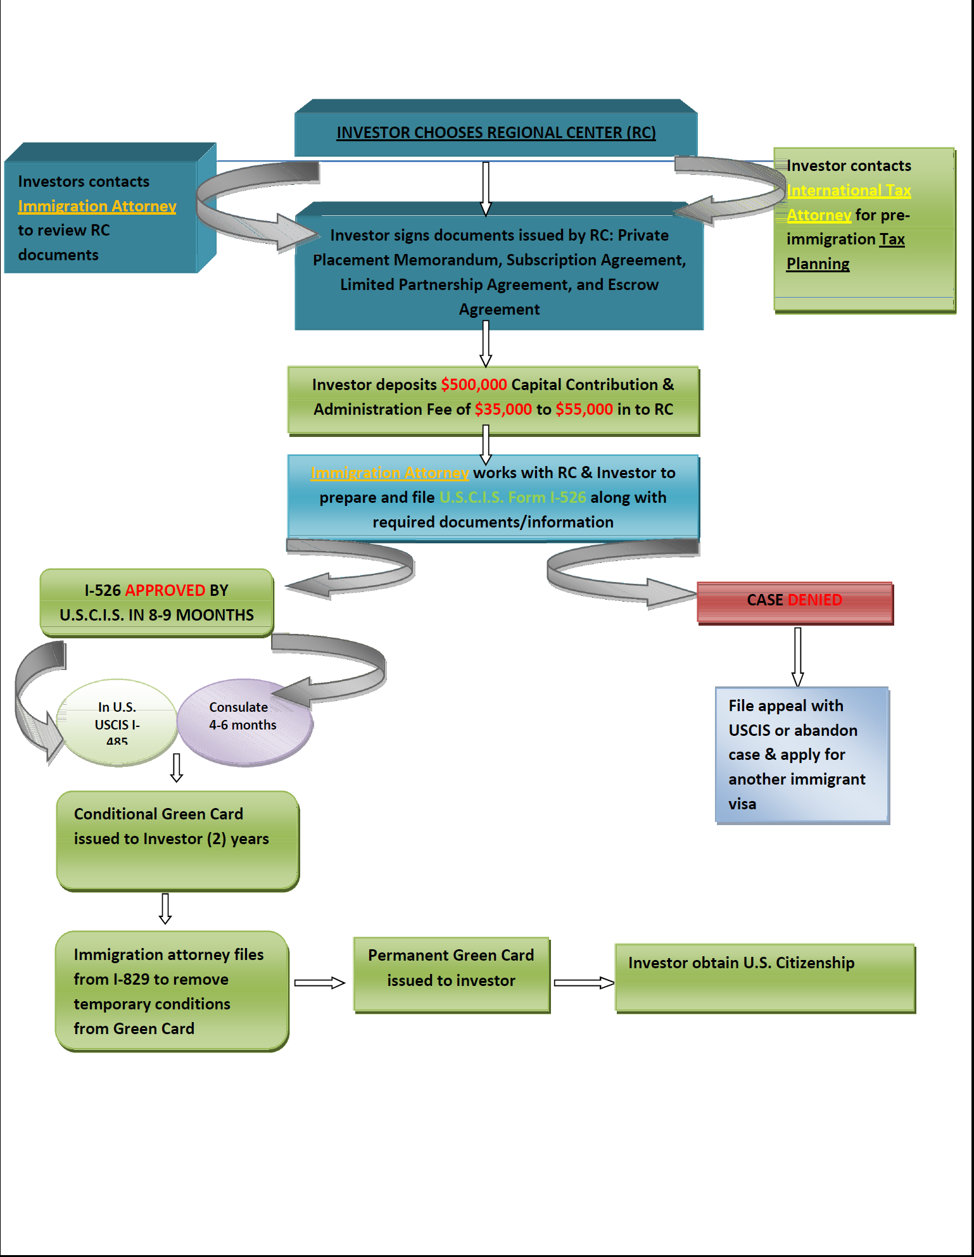
EB-5 Investor Flowchart & Timeline

Slide 13
Regional Centers
USCIS approved investment project
In order to qualify the investor must show
Evidence that the investment is made in a designated Regional Center according to the approved regional center business plan
Evidence, if applicable, that the business has been established in a targeted employment area
Evidence that you have invested or are in the process of investing the amount required ($1,000,000 or $500,000).
Evidence that the investment funds were obtained through lawful means
Evidence that your investment in the Regional Center will create at least 10 direct or indirect full-time jobs

Slide 14
com/
The Law Offices of Yuri Tsyganov, PL 111 N. Pine Island Road Suite 205 Plantation, FL 33324 www.EB5InvestGreenCard.com

